Slide 1

Credit vs Equity Beta
The case of CDX North America IG and SPY
Econometrics for Financial Markets Project
Team:
Silvia Adaggio - 2011167
Beatrice Saccucci - 1786623
Paolo Manenti - 1999957
Alessandro Lanzo - 1995464
Professor Stefano Galiani

Slide 2
Table of contents
01
02
03
04
Introduction to financial instruments
Credit Default Swap Theory
A volatility measure: Beta Coefficient
Applications

Slide 3
01
Introduction to financial instruments

Slide 4
Introduction to financial instruments
A financial instrument is defined as a contract between parties that hold a monetary value.
Financial Instruments
Cash Instruments
Derivatives
Equity
Deposits and Loans
Forward
Structured Products
Futures
Swap
Options
CDS

Slide 5
Credit Default Swap Theory
02

Slide 6
CDS Theory
They are financial instruments that include risk hedging, speculation and arbitrage
Which are the parties included in a CDS contract?
Periodic premium payments
(Insurance payment)
Protection buyer
Protection Seller
Payment in case of credit event

Slide 7
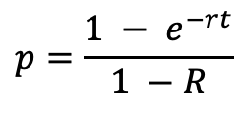





CDS Theory
The price of a CDS concerns the probability of a credit event;
it can be obtained through the default probability and the recovery rate.
Default Probability (No recovery rate)
Default Probability (With recovery rate)
$$\left(1 −p\right)e^{\left(z+r\right)t}$$
$$\left(1 −p\right)e^{\left(z+r\right)t}+pRe^{\left(z+r\right)t}$$
$$e^{zt}$$
$$e^{zt}$$
$$p=\frac{{1 − e}^{−rt}}{1 −R}$$
$$p=1 −e^{−rt}$$

Slide 8


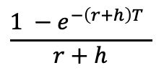
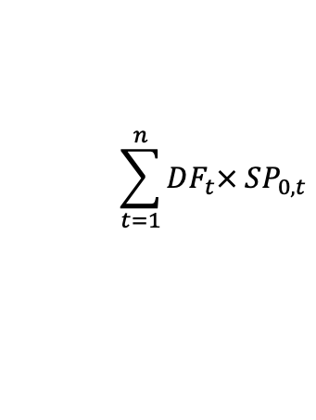
CDS Theory
$$CDS_{returns}={(s}_{t} −{ s}_{t−1}) × RISKYDV01$$
The Risky DV01 measures the present value of 1bp risky annuity received or paid until the occurrence of a credit event or the expiration of the contract.
$$\sum_{t=1}^{n}{DF_{t}× SP_{0,t}}$$
$$h= \frac{s_{today}}{1 −R}$$
$$\frac{1 −e^{−\left(r+h\right)T} }{r+h}$$
Credit Triangle

Slide 9
Beta Coefficient
03

Slide 10
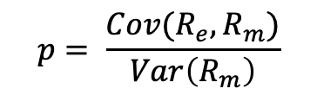
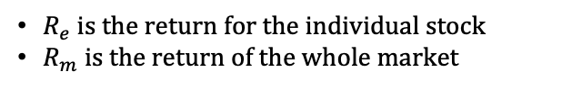
Beta coefficient
The beta represents a risk measure of the volatility of a security (or portfolio) compared to a benchmark. Its most common application is in the CAPM, where it is interpreted as the slope of the line through a regression of data points, where each of these stands for an individual stock’s returns against those of the market as a whole.
$$p= \frac{Cov(R_{e}, R_{m})}{Var\left(R_{m}\right)}$$
$R_{e}$ is the return for the individual stock
$R_{m}$ is the return of the whole market
REMARK: According to the data chosen for the analysis, it is important to point out a slight difference for the values in the formulation: if we are considering two different types of markets, the less volatile will be used to compute the variance

Slide 11
Applications
04

Slide 12
Applications
Equity benchmark
Credit Default Swap
SPY: It tracks the S&P 500 index, the benchmark U.S. It is a market-cap weighted index, and this is to say that larger companies have greater weights.
CDX North America IG: A portfolio composed by 125 CDS with rating from BBB to above.
CDX North America HY: A portfolio composed by 100 CDS with rating from BBB to below.
SX5E: It is a stock index of Eurozone and is composed by fifty of the largest and most liquid stocks.
iTraxx Europe Main: A portfolio composed by 125 CDS with rating from BBB to above.
IWM: It tracks the Russell 2000 index, the benchmark small-cap U.S. equity index and is characterized by companies ranked 1001st – 3000st by market cap.
iTraxx Europe Crossover: A portfolio composed by 70 CDS with rating from BBB to below.

Slide 13
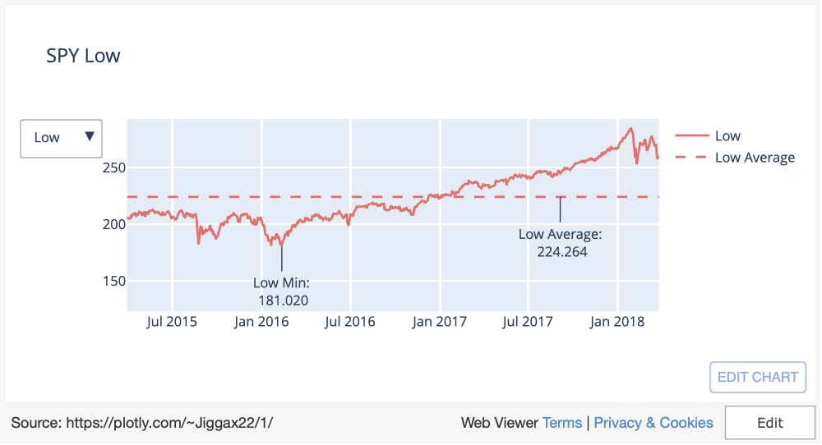
Equity prices
Notes:
https://plotly.com/~Jiggax22/1/

Slide 14
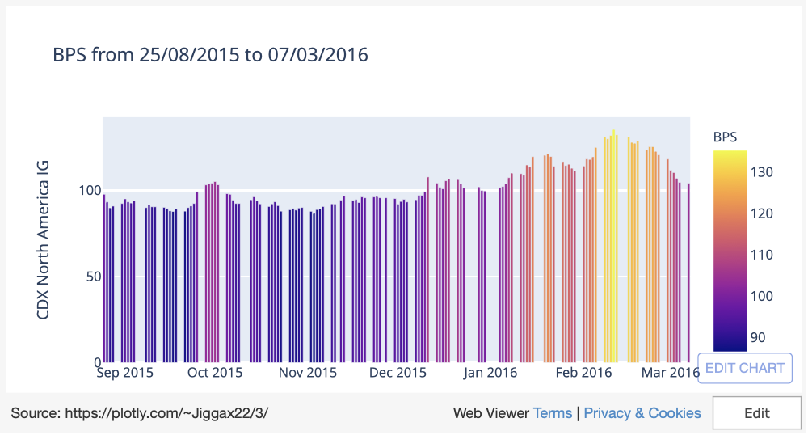
Notes:
https://plotly.com/~Jiggax22/3/

Slide 15
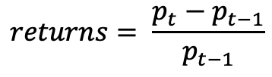
Simple returns
The simple returns for the benchmarks and the CDX North America HY have been computed as:
$$returns= \frac{p_{t}−p_{t−1}}{p_{t−1}}$$
 | SPY | SX5E | IWM | CDX North America HY
31/03/2015 | -0,874% | -0,816% | -0,321% | 0,087%
01/04/2015 | -0,354% | 0,474% | 0,040% | 0,096%
02/04/2015 | 0,360% | 0,010% | 0,185% | 0,048%
07/04/2015 | 0,407% | 1,439% | -0,201% | 0,413%
Python Code

Slide 16
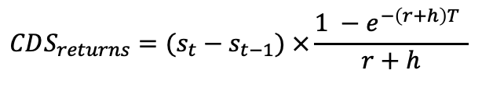
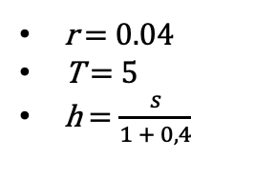
Simple returns
The returns for the CDX North America IG, iTraxx Europe Main and iTraxx Europe Crossover, instead, are computed as:
$$CDS_{returns}={(s}_{t} −{ s}_{t−1}) ×\frac{1 −e^{−\left(r+h\right)T} }{r+h}$$
r = 0.04
T = 5
h = $\frac{s}{1 + 0,4}$
 | CDX North America IG | iTraxx Europe Main | iTraxx Europe Crossover
31/03/2015 | 0,013% | 0,018% | 0,033%
01/04/2015 | 0,022% | -0,027% | 0,090%
02/04/2015 | 0,022% | -0,035% | -0,029%
07/04/2015 | 0,106% | 0,075% | 0,246%
Python Code

Slide 17
Conclusions
Finally, through the implementation of this analysis, we have been able to compute the Beta coefficient using the previously described formula. As pointed out before, it has been calculated for the CDX North America IG and SPY.
The covariance among the two is 0,000005 and the variance of the less volatile financial instrument is $6.100e^{−7}.$
This two values lead us to obtain the Beta coefficient, that is:
8.35x
Python Code

Slide 18
Thanks!

Slide 19
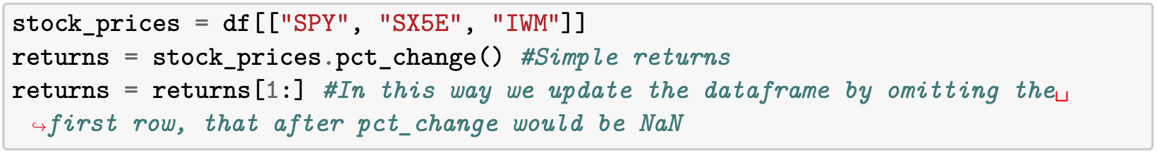
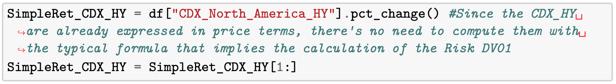
Returns for the benchmark
Python Code
Back to the previous slide

Slide 20
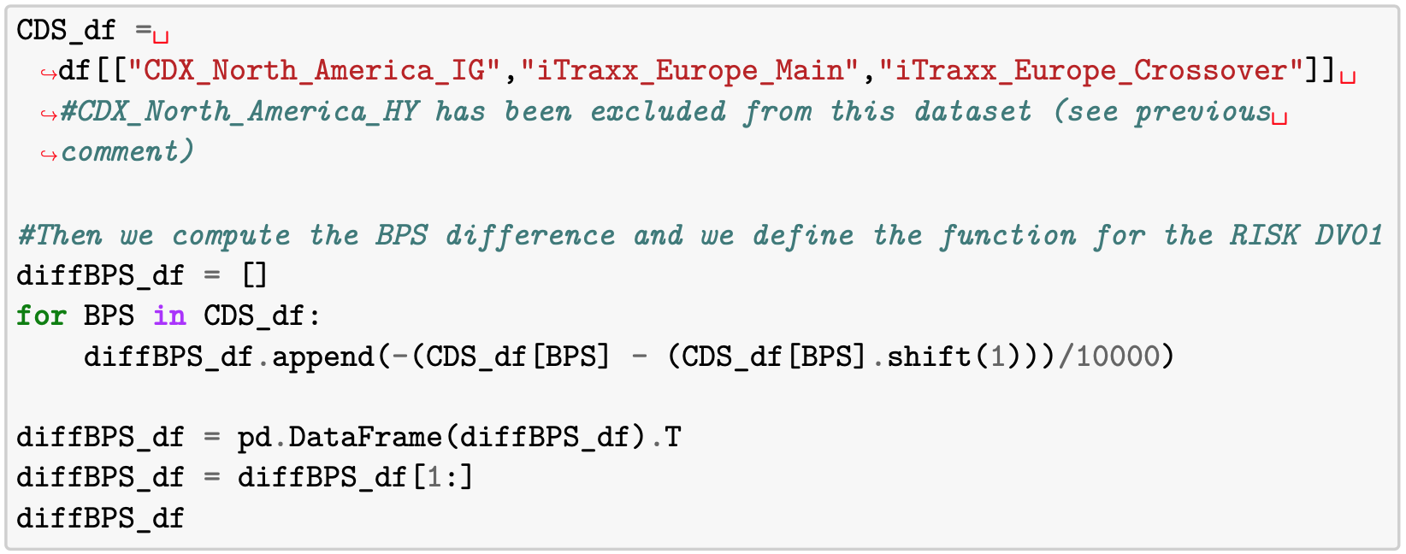
Returns for the CDS
Python Code - 1

Slide 21
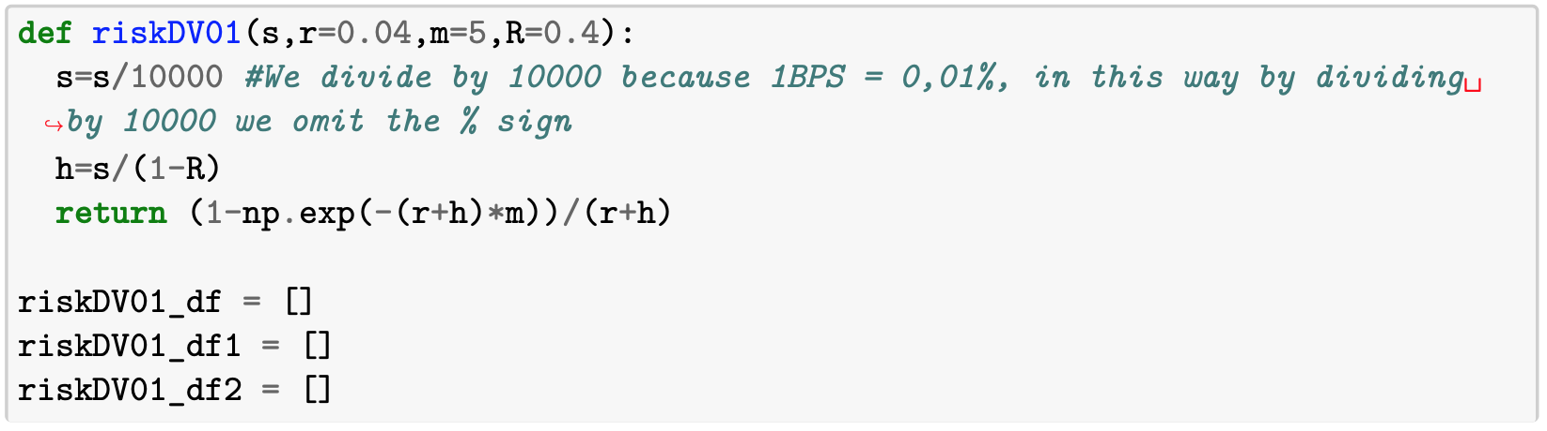
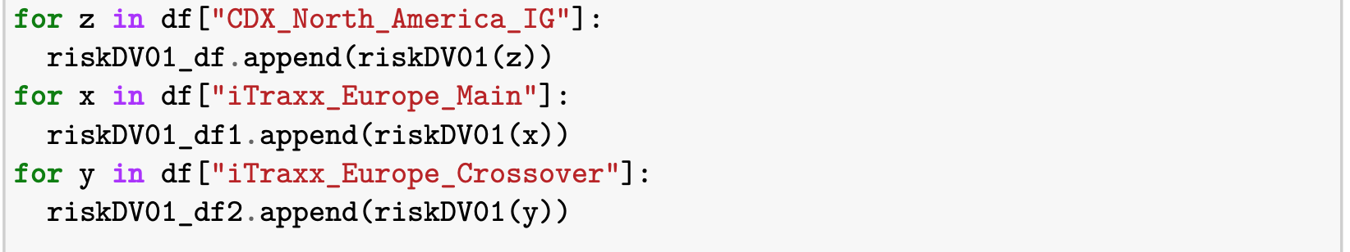
Returns for the CDS
Python Code - 2

Slide 22
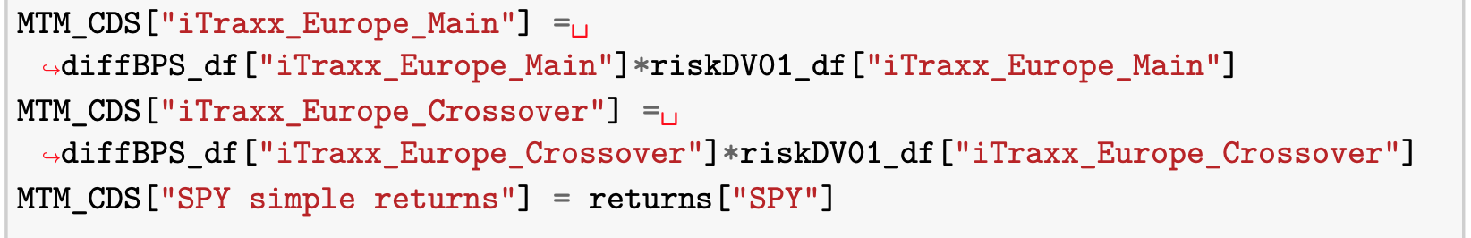
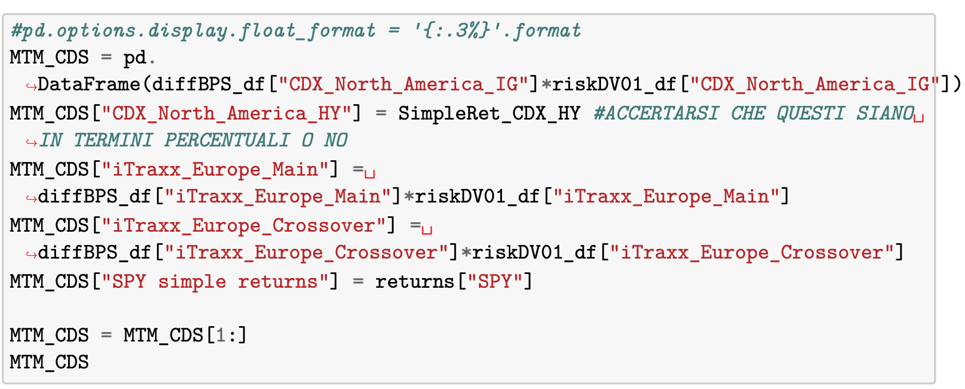
Returns for the CDS
Python Code - 3
Back to the previous slide

Slide 23
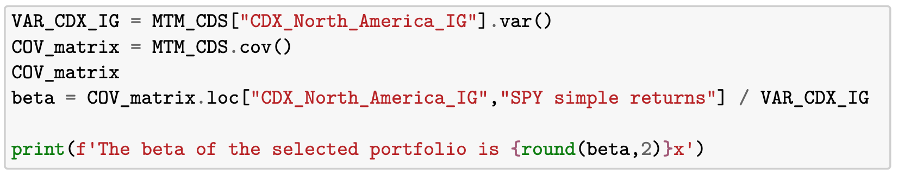
Beta Calculation
Python Code
Back to the previous slide

